Slide 1

Jeopardy! Tutorial
This template is ready to use but since Jeopardy! is a quiz show, you can change the questions and answers of the template, in order to adapt the game to your topics.
Please do not delete whole slides, otherwise we can not guarantee a smooth game experience and problems may occur.
However, you can change texts, the music and colours. In the next slides we will give you a detailed explanation to learn how to play the game and adapt it to your ideas.
Have a lot of fun with our JEOPARDY! game!

Slide 2
Rules of Jeopardy!
To start the game, click on the first Jeopardy! Slide and start the presentation by clicking on the menu Slide Show > From Current Slide.
Now the intro with music starts playing and you only must click one more time to run the begin animation. When the second money board appears, the first player can choose the category and money- value by clicking on the field. (With the increasing amount of money, the difficulty of the questions also increases!)
As soon the question appears, the players have 30 seconds to think about it. (until music ends) When one person raises his arm (or shouts) he/ she can answer. Answers must be phrased as questions, unless it’s said differently.
Right answer? Then the player gets the amount of money, the question is worth. Take a sheet and write down the value to the persons' name. If he guessed it wrong, the other players could try their luck. If time runs out, or no one got it, no one will get any points. The person with the highest amount of money, wins.
Advanced version: guessing it wrong will subtract the amount of money from the players account; negative values are also accurate.

Slide 3
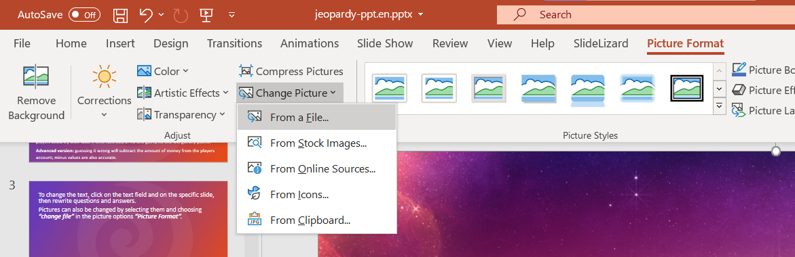

To change the text, click on the text field on the specific slide, then rewrite questions and answers.
Pictures can also be changed by selecting them and choosing “From a File” in the picture options “Picture Format”.
Some pictures are hidden behind other elements. In order to change them, move objects around and bring them to the front or back by right-clicking them and choosing the option.

Slide 4

More information can be found on our blog:
https://slidelizard.com/blog/jeopardy-powerpoint-template

Slide 6

PLEASE CLICK TO START THE GAME!

Slide 7




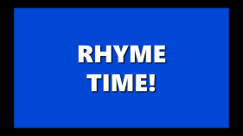


$ 200
$ 200
$ 200
$ 200
$ 200
$ 200
$ 400
$ 400
$ 400
$ 400
$ 400
$ 400
$ 600
$ 600
$ 600
$ 600
$ 600
$ 600
$ 800
$ 800
$ 800
$ 800
$ 800
$ 800
$ 1000
$ 1000
$ 1000
$ 1000
$ 1000
$ 1000

Slide 8


Slide 9
NETWORK SECURITY

Slide 11
CTF TOOLS

Slide 13
PHYSICAL SECURITY

Slide 15
CYBER DEFENSE PRACTICES

Slide 17
CYBER ATTACKS

Slide 19
CYBER EVENTS

Slide 20

































NETWORK SECURITY
PHYSICAL SECURITY
CYBER DEFENSE
CYBER ATTACKS
CYBER EVENTS
CTF TOOLS
YOU FINISHED THIS GAME
TIME TO COUNT THE MONEY!

Slide 21
WHAT NETWORK SECURITY DEVICE IS DESIGNED TO FILTER AND INSPECT INCOMING AND OUTGOING NETWORK TRAFFIC
Click here for the answer

Slide 22
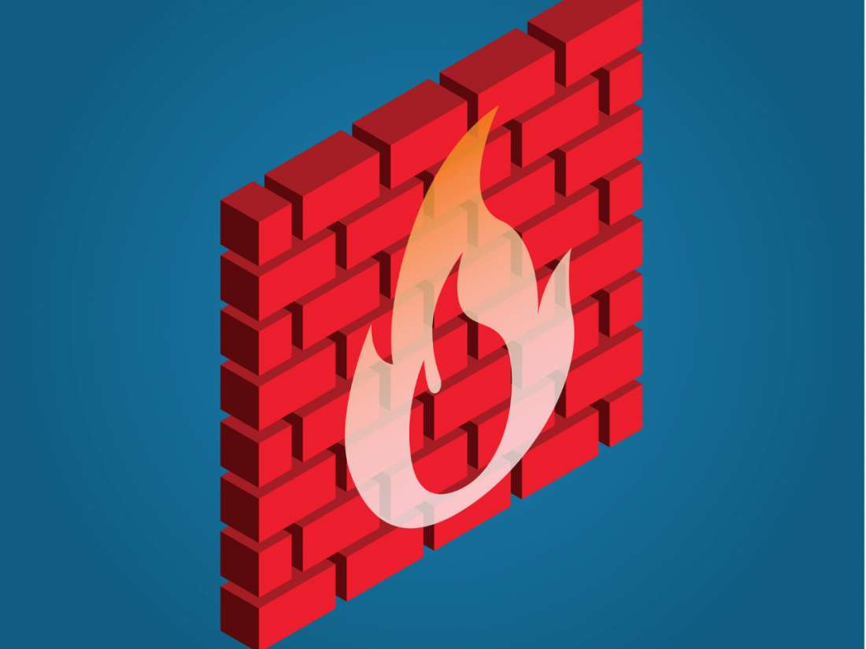
Solution:
WHAT IS A FIREWALL?
$ 200

Slide 23
TOOL THAT PROVIDES A SECURE CONNECTION OVER AN UNSECURE NETWORK
Click here for the answer

Slide 24
Solution:
WHAT IS A VIRTUAL PRIVATE NETWORK (VPN)?
$ 400

Slide 25
WHICH PROTOCOL IS USED FOR SECURE REMOTE SHELL ACCESS TO NETWORK DEVICES AND SERVERS
Click here for the answer

Slide 26

Solution:
WHAT IS SSH (Secure Shell)?
$ 600

Slide 27
BREAKS DOWN LARGER NETWORK INTO VARIOUS SUBNETWORKS. IF ANY OF THE SUBNETWORKS ARE INFILTRATED, THE OTHERS ARE LEFT UNTOUCHED BECAUSE THEY ARE INDEPENDENT OF EACH OTHER
Click here for the answer

Slide 28
Solution:
WHAT IS NETWORK SEGMENTATION?
$ 800

Slide 29
MAPPING MULTIPLE PRIVATE ADDRESSES INSIDE A LOCAL NETWORK TO A PUBLIC IP ADDRESS. GOOD FOR PRIVATE IP ADDRESS CONCEALMENT
Click here for the answer

Slide 30
Solution:
WHAT IS NETWORK ADDRESS TRANSLATION (NAT)?
$ 1000

Slide 31
A VALUABLE RESOURCE ALLOWED IN MOST CTF CHALLENGES. YOU CAN ACCESS THIS RESOURCE ON ALMOST ANY ELECTRONIC DEVICE
Click here for the answer

Slide 32

Solution:
WHAT IS THE INTERNET/GOOGLE?
$ 200

Slide 33
THIS APPLICATION IS USEFUL FOR ANALYZING PACKET CAPTURE (PCAP) FILES AND SEARCHING FOR SUSPICIOUS TRAFFIC PATTERNS
Click here for the answer

Slide 34

Solution:
WHAT IS WIRESHARK?
$ 400

Slide 35
THIS OPEN-SOURCE REVERSE ENGINEERING TOOL DEVELOPED BY THE NSA IS USEFUL FOR DISASSEMBLING BINARIES
Click here for the answer

Slide 36

Solution:
WHAT IS GHIDRA?
$ 600

Slide 37
A POWERFUL WEB APP THAT CAN BE USED TO ENCODE OR DECRYPT DATA WITHOUT THE USE OF COMPLEX ALGORITHMS
Click here for the answer

Slide 38
Solution:
WHAT IS CYBERCHEF?
$ 800

Slide 39
LINUX TOOL THAT IS USED FOR SEARCHING A GIVEN BINARY IMAGE FOR EMBEDDED FILES AND EXECUTABLE CODE
Click here for the answer

Slide 40
Solution:
WHAT IS BINWALK?
$ 1000

Slide 41
THE LIST OF COMPUTERS, LAPTOPS, SOFTWARE, EQUIPMENT OWNED BY AN ORGANIZATION
Click here for the answer

Slide 42
Solution:
WHAT IS INVENTORY?
$ 200

Slide 43
OVERLAPPING LAYERS OF PROTECTION PUT IN PLACE SO THAT IF ONE LAYER FAILS OTHER LAYERS SUCCEED IN PROTECTING IS KNOWN AS…
Click here for the answer

Slide 44
Solution:
WHAT IS DEFENSE IN DEPTH?
$ 400

Slide 45
PERCEIVED THREAT TO AN ORGANIZATION THAT COMES FROM PEOPLE WITHIN THE ORGANIZATION
Click here for the answer

Slide 46
Solution:
WHAT IS INSIDER THREAT?
$ 600

Slide 47
THE USE OF PERSONALITY, KNOWLEDGE OF HUMAN NATURE AND SOCIAL SKILLS TO STEAL PASSWORDS, KEYS, YOKENS, OR OTHER CREDENTAILS TO GAIN ACCESS TO SYSTEMS
Click here for the answer

Slide 48
Solution:
WHAT IS SOCIAL ENGINEERING?
$ 800

Slide 49
A NECESSARY PROCESS (A SET OF GUIDELINES) THAT ORGANIZATIONS USE TO IMPROVE THEIR CYBERSECURITY POSTURE AND REDUCE EXPOSURE TO SECURITY WEAKNESSES
Click here for the answer

Slide 50
Solution:
WHAT IS STANDARDIZATION?
$ 1000

Slide 51
WHAT TYPE OF CYBER TOOL IS DESIGNED TO DETECET AND RESPOND TO SECURITY INCIDENTS WITHIN A NETWORK?
Click here for the answer

Slide 52
Solution:
WHAT IS AN INTRUSION DETECTION SYSTEM (IDS)?
$ 200

Slide 53
WHAT SECURITY CONCEPT INVOLES CREATING A DUPLICATE ENVIRONMENT TO TEST AND VALIDATE SECURITY MEASURES WITHOUT AFFECTING THE PRODUCTION SYSTEM?
Click here for the answer

Slide 54
Solution:
WHAT IS A SANDBOX/VIRTUAL MACHINE (VM) ENVIRONMENT?
$ 400

Slide 55
AN AUTHORIZED SIMULATED CYBERATTACK TEST ON A COMPUTER SYSTEM TO EVALUATE THE SECURITY OF THE SYSTEM
Click here for the answer

Slide 56
Solution:
WHAT IS PENETRATION TESTING?
$ 600

Slide 57
A SACRIFICIAL COMPUTER SYSTEM THAT’S INTENDED TO ATTRACT CYBERATTACKS LIKE A DECOY
Click here for the answer

Slide 58
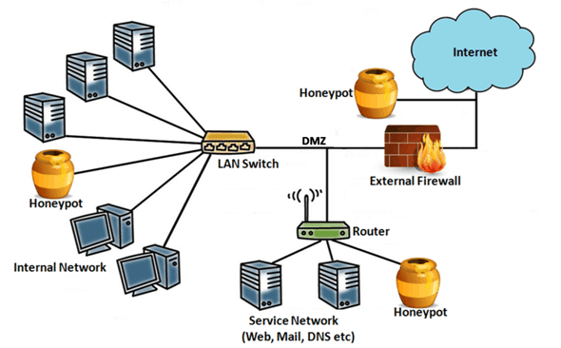
Solution:
WHAT IS A HONEYPOT?
$ 800

Slide 59
A SYSTEM THAT HELPS ORGANIZATIONS DETECT, ANALYZE, AND RESPOND TO SECURITY EVENTS/THREATS BEFORE THEY HARM BUSINESS OPERATIONS
Click here for the answer

Slide 60
Solution:
WHAT IS A SECURITY INFORMATION AND EVENT MANAGEMENT (SIEM) system?
$ 1000

Slide 61
MALICIOUS SOFTWARE THAT PREVENTS YOU FROM ACCESSING YOUR FILES AND DEMANDS YOU PAY A RANSOM FOR THEIR RETURN
Click here for the answer

Slide 62
Solution:
WHAT IS A RANSOMWARE ATTACK?
$ 200

Slide 63
FRADULENT PRACTICE OF SENDING MALICIOUS LINKS AND ATTACHEMENTS TO BE FROM REPUTABLE COMPANIES IN ORDER TO INDUCE USERS TO REVEAL PERSONAL INFORMATION
Click here for the answer

Slide 64
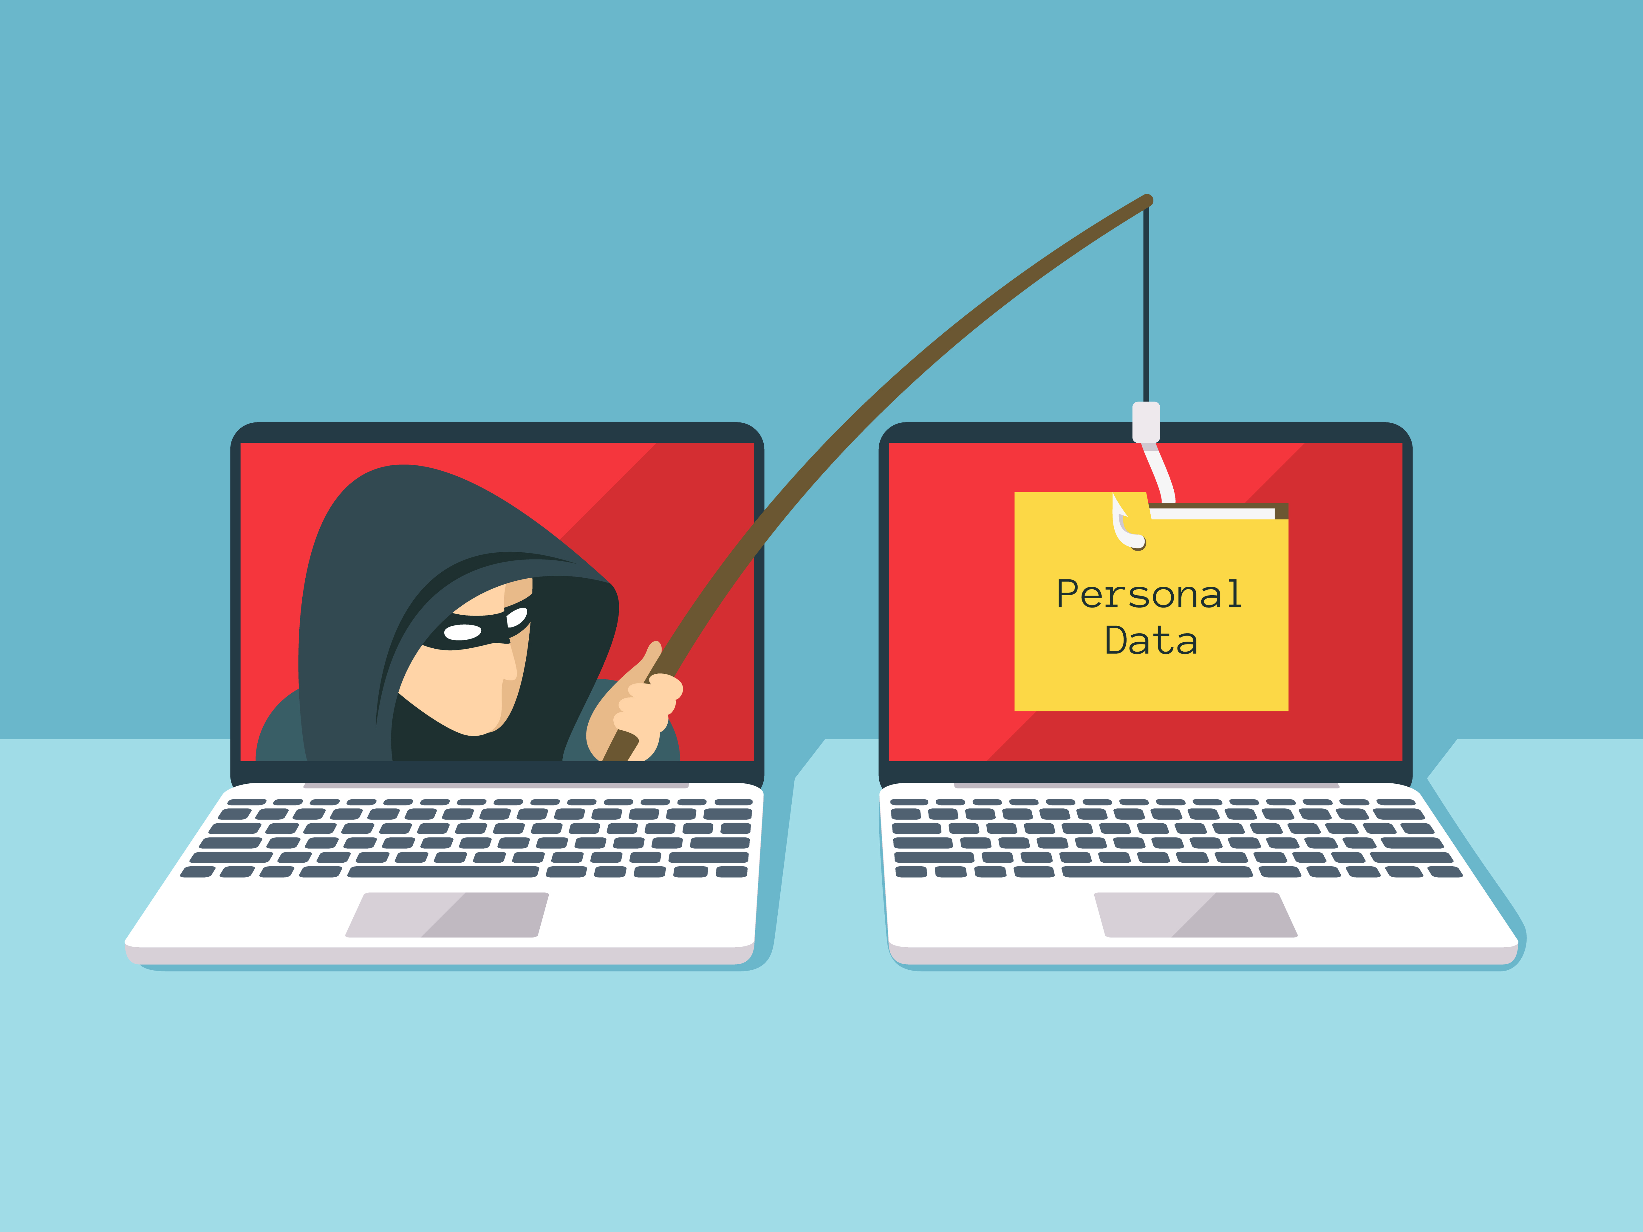
Solution:
WHAT IS A PHISHING ATTACK?
$ 400

Slide 65
BREACH IN CYBERSECURITY THAT MAKES IT POSSIBLE FOR AN ATTACKER TO EAVESDROP DATA SENT BACK AND FORTH BETWEEN TWO PEOPLE OR NETWORKS
Click here for the answer

Slide 66
Solution:
WHAT IS A MAN IN THE MIDDLE ATTACK?
$ 600

Slide 67
COMMON METHOD OF TAKING ADVANTAGE OF WEBSITES THAT DEPEND ON DATABASES TO SERVE THEIR USERS. MALICIOUS STATEMENTS ARE INSERTED INTO AN ENTRY FIELD FOR EXECUTION
Click here for the answer

Slide 68
Solution:
WHAT IS AN SQL INJECTION ATTACK?
$ 800

Slide 69
A CRYPTOGRAPHIC ATTACK THAT RELIES ON A ___ PARADOX TO FIND A COLLISION IN A HASH FUNCTION, WHICH COULD RESULT IN THE ATTACKER ABUSING COMMUNICATION BETWEEN TWO OR MORE PARTIES
Click here for the answer

Slide 70
Solution:
WHAT IS A BIRTHDAY ATTACK/PARADOX?
$ 1000

Slide 71
1988 self-replicating worm became one of the first major cyber attacks, causing significant disruption on early internet. What was it called?
Click here for the answer

Slide 72
Solution:
WHAT IS THE “MORRIS WORM“ (INTERNET WORM)?
$ 200

Slide 73
2007 cyberattack targeted Estonia, crippling government websites and banks. What type of attack was it?
Click here for the answer

Slide 74
Solution:
WHAT IS DISTRIBUTED DENIAL OF SERVICE (DDoS) ATTACK?
$ 400

Slide 75
In 2013, this former NSA contractor leaked classified information to the media, revealing surveillance programs. Who is this person?
Click here for the answer

Slide 76
Solution:
WHO IS EDWARD SNOWDEN?
$ 600

Slide 77
This 2017 ransomware attack affected over 200,000 computers in 150 countries, encrypting files and demanding a Bitcoin ransom. What was it called?
Click here for the answer

Slide 78
Solution:
WHAT IS THE WANNACRY RANSOMWARE ATTACK?
$ 800

Slide 79
This infamous cyberattack in 2010 targeted Iran’s nuclear program using a computer worm. What was it called?
Click here for the answer

Slide 80
Solution:
WHAT IS THE STUXNET WORM?
$ 1000

Slide 81
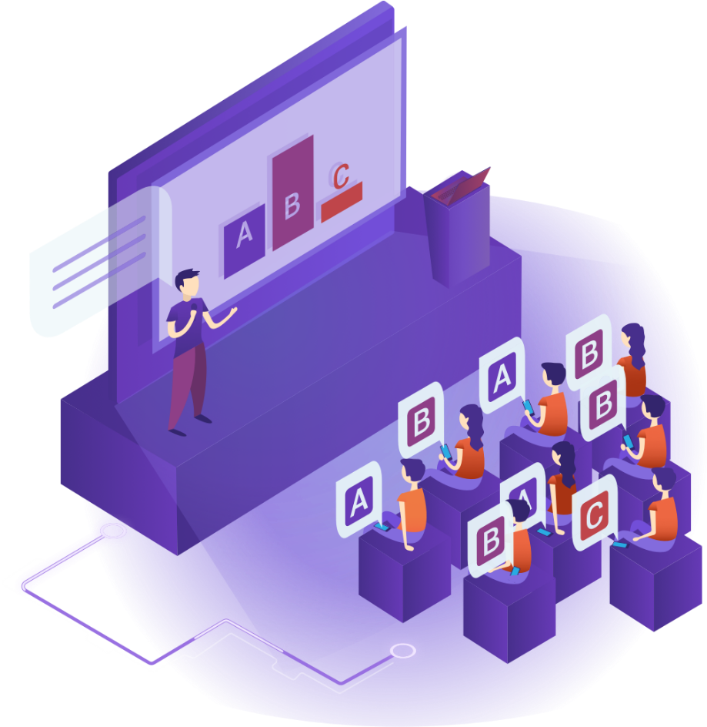

Free Download:
https://slidelizard.com

